Slide 1


Project Presentation (KCS 851) (Codeforces Analyser)
KIET Group of Institutions, Ghaziabad
(An ISO – 9001: 2008 Certified & ‘A+’ Grade accredited Institution by NAAC)
Guide Name: Prof. Sreesh Gaur
Project Members Name with Roll Number & Section
1. Priyanshi, 2000290120117, CS 8B
2. Priyanshu Raj, 2000290120119, CS 8B
3.Sagar Srivastava, 2000290111038, CS 8B

Slide 2
Problem Statement
To make a fully functional dynamic website to keep a track of complete happenings of Codeforces platform.
To ease the tracking and analyses of skills acquired along with the growth undertaken in a simplified and user friendly manner.
In addition, it seeks to address and resolve the following issues:-
Limited user Profile Insights
Difficulty in comparing User Profiles
Lack of Peak performance Analysis

Slide 3
Objectives
The primary objective of the Codeforces Analyser project is to create a user-friendly analytics and visualization platform that leverages the Codeforces API to enable users to:
Visualize and understand their competitive programming journey on Codeforces.
Analyse their performance trends, including rating history and contest participation.
Compare their Codeforces profiles with those of other users.
Identify areas for improvement and set performance goals.
Track and visualize their highest positive rating achieved over time.
In essence, this project aims to enhance the Codeforces user experience by providing valuable insights, encouraging healthy competition, and fostering a sense of community among competitive programmers on the platform.

Slide 4
Technology Used
Domain of the Project :- Full Stack Development
Front end :- HTML,CSS, JavaScript, ReactJS
Backend :-Google Charts, MySQL, MDL
Version Control :- GitHub
Testing:- Jest

Slide 5
Literature Survey
Paper Title: Codeforces Analyser using API Integration
Author name: Smith, J., & Brown, A.
Journal Name: "Enhancing Learning Experience through Coding Platforms: A User-Centric Perspective
Year of publishing: 2019
Followed by Summary of papers:
The paper consisted on the the details about how a responsive web design could be created. Responsive web design is a technique that allows a website to adapt to the device where a page is loading or being accessed , such as a desktop, laptop, tablet or smartphone. It uses flexible layouts and aims to provide a better user experience, accessibility and performance for web pages across different devices.

Slide 6
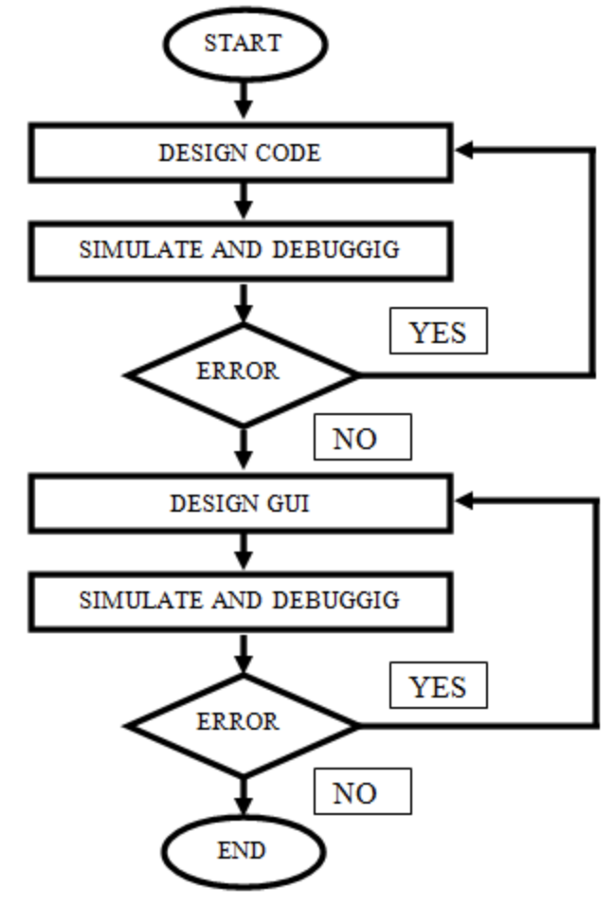
Workflow Diagram:-

Slide 7
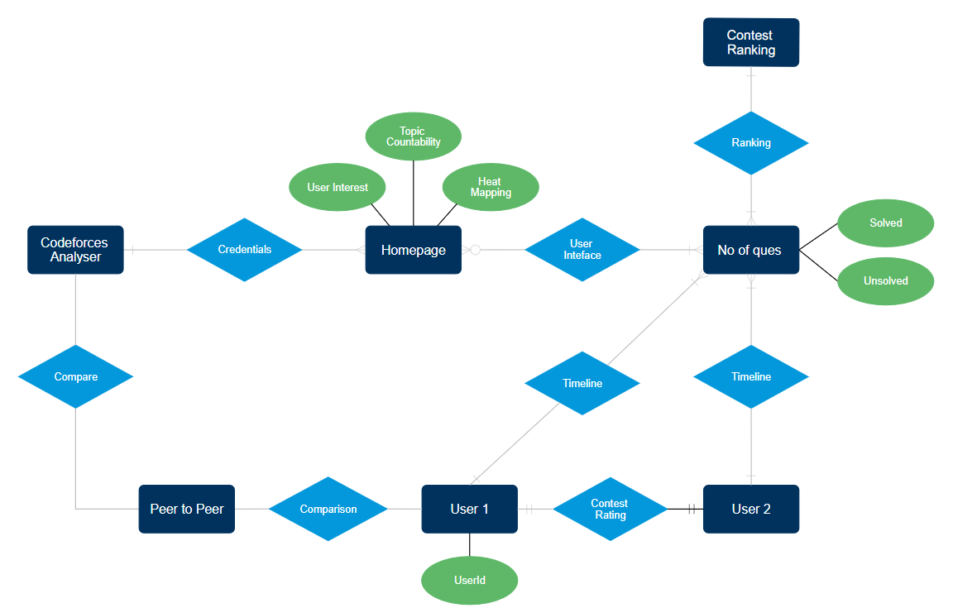
ER Diagram

Slide 8

Patent Status

Slide 9
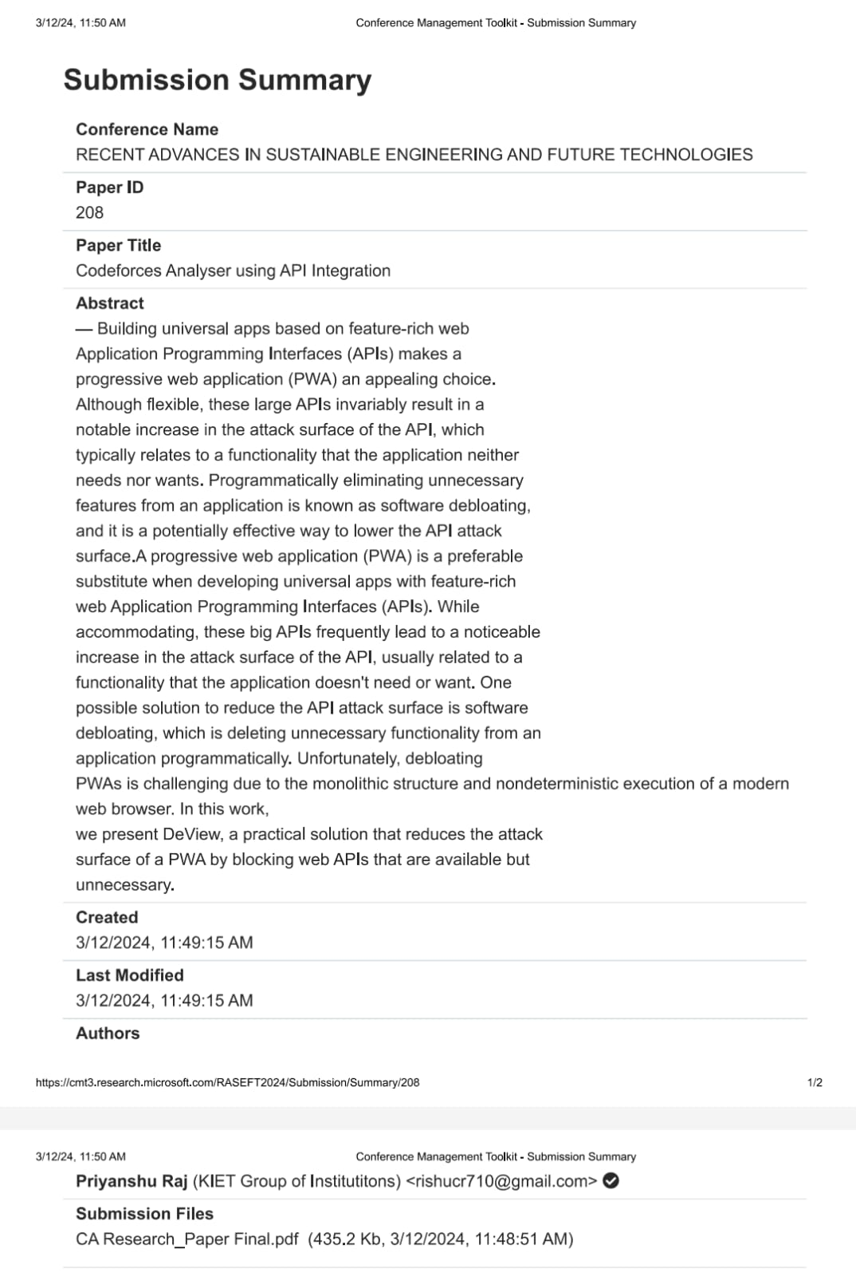
Research Paper Status
Research paper submitted to conference and waiting for approval.

Slide 10
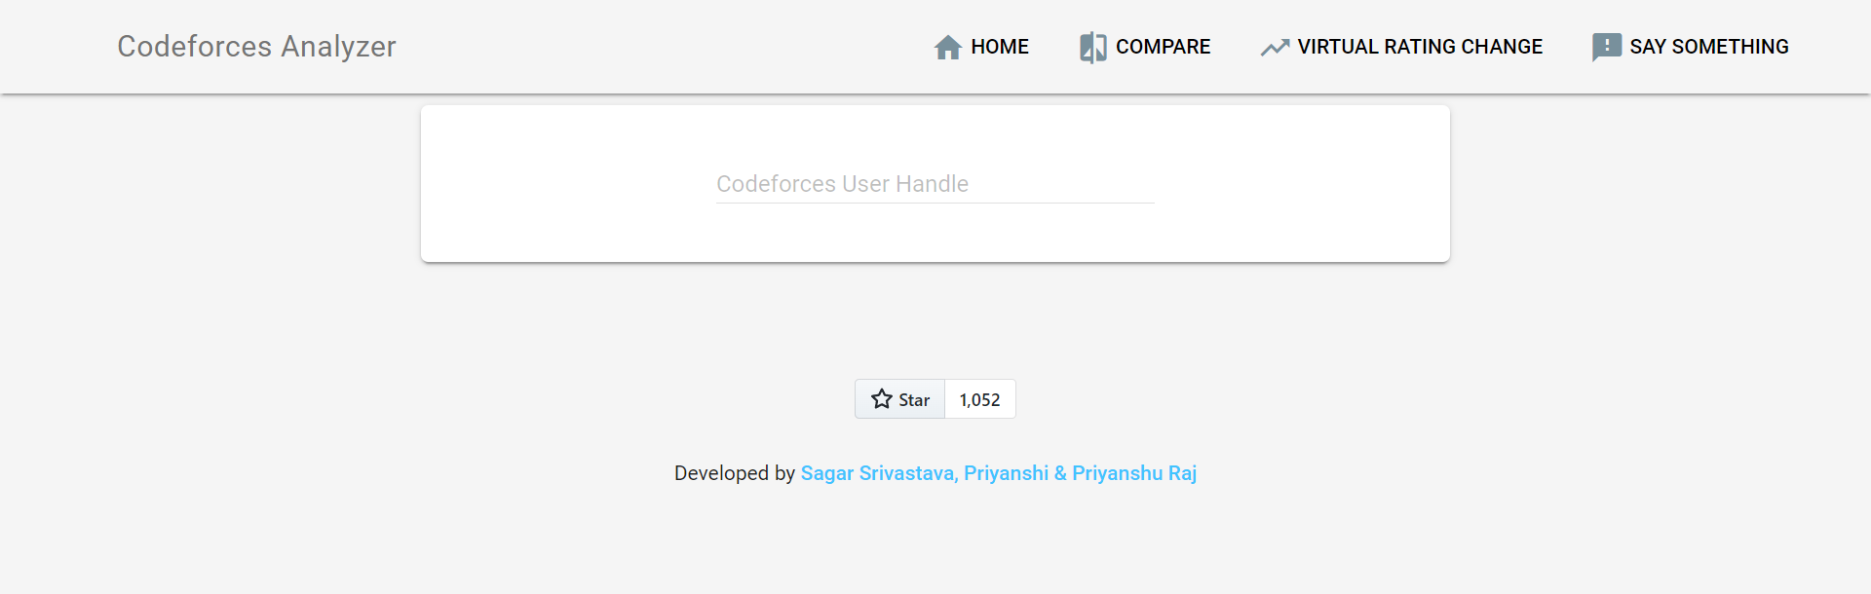
Project Status
Project completed successfully, achieving all objectives.
Working of project with the help of Screenshots:-

Slide 11
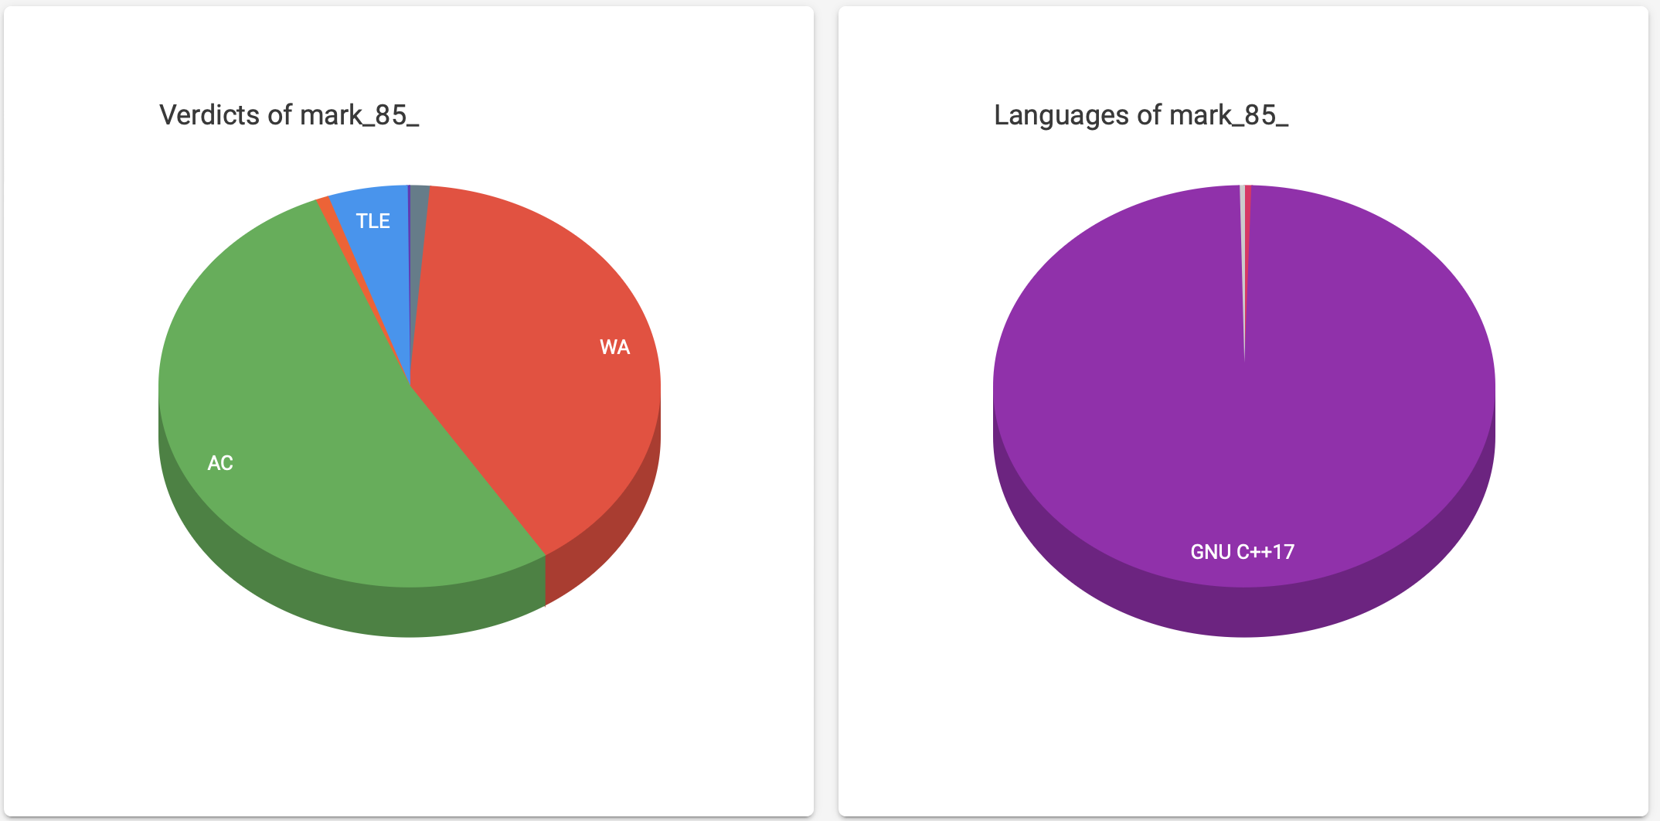
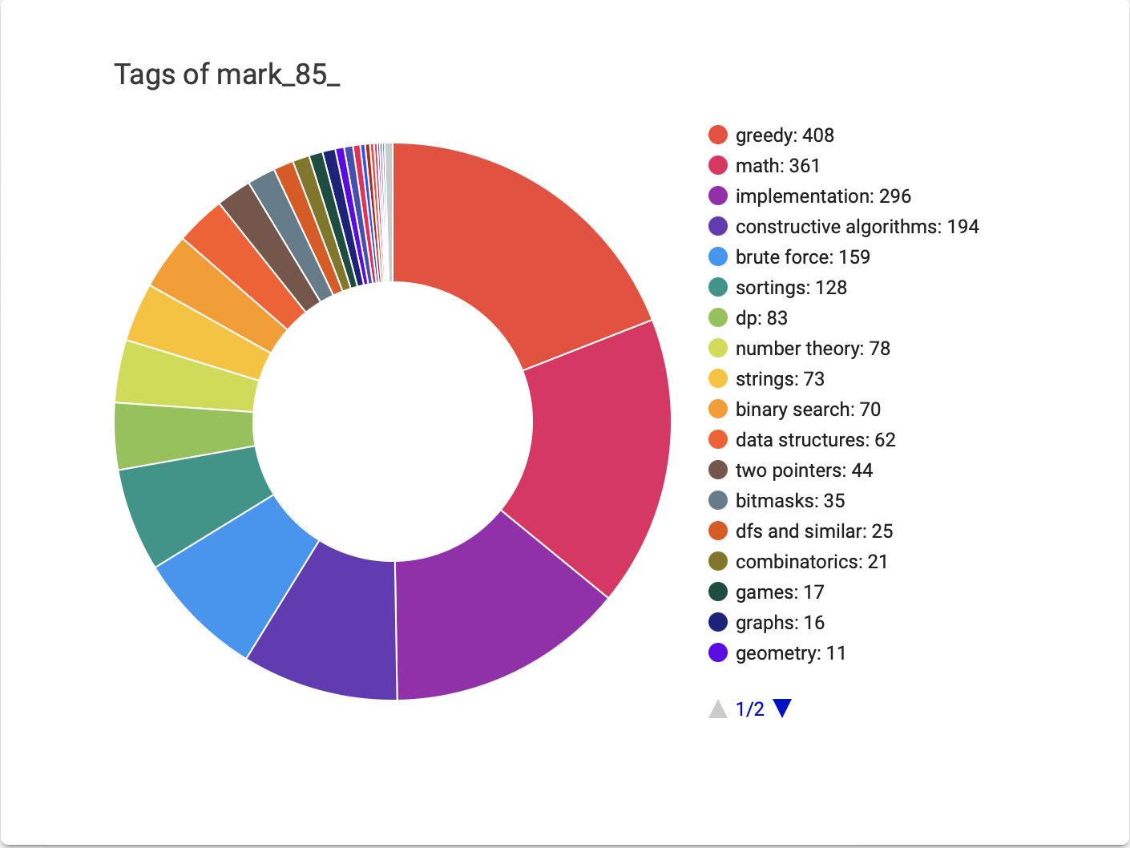
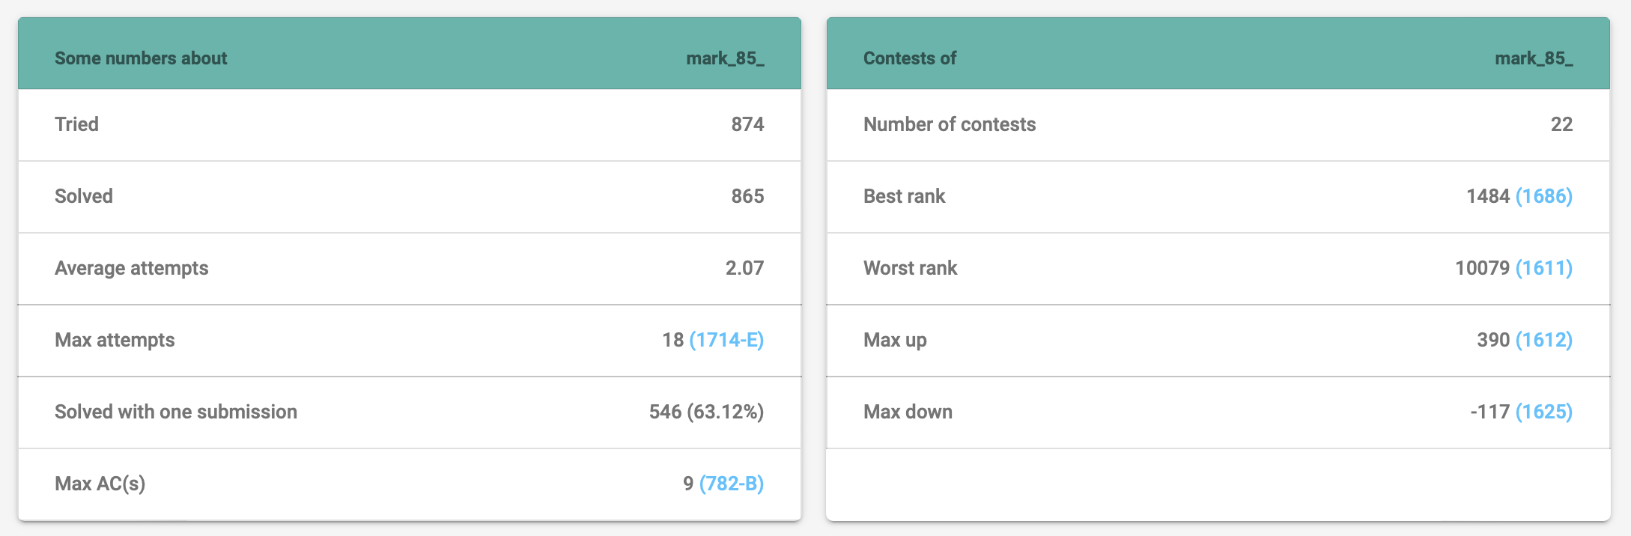

Slide 12
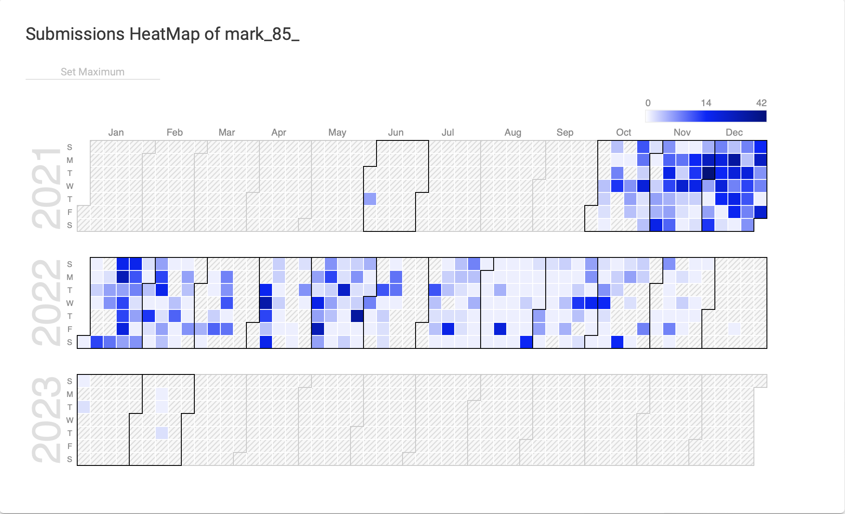

Slide 13
References
[1]. Atcoder. (2020). "Codeforces - Atcoder Integration." [Online]. Available: [Link to Atcoder Integration].
[2]. Codeforces. (2021). "Codeforces API Documentation." [Online].
[3]. Smith, J., & Brown, A. (2019). "Enhancing Learning Experience through Coding Platforms: A User-Centric Perspective." Journal of Educational Technology, 15(2), 112-125.
[4]. Johnson, M., & Patel, R. (2020). "Real-time Feedback Mechanisms in Coding Platforms: A Comparative Analysis." International Journal of Computer Science, 28(4),245-260
[5]. Chen, L., & Wang, Q. (2018). "Impact of Online Coding Platforms on Programming Proficiency: A Longitudinal Study." Journal of Computer Science Education, 22(1), 88-104.
[6]. Rodriguez, A., & Kim, S. (2021). "Evolutionary Trends in Competitive Programming Platforms: A Comprehensive Review." Proceedings of the ACM Conference on Software Engineering, 36(3), 212-225.
[7]. Future Trends in Competitive Programming Research Group. (2022). "Future Trends and Innovations in Competitive Programming." Journal of Programming and Algorithms, 45(2), 189-202.
[8]. Codeforces. (2022). "Codeforces API Documentation."
[9]. Competitive Programming. (2020). "The Role of Competitive Programming in Skill Development." Journal of Coding Excellence.

